Slide 1


JOB Brain

Slide 2





Problem & Solution
Application Process
Swipe Right
Users are required to manually enter their resume information again when using job portals.
Fill in all your information on the job portal by swiping right.
Tedious
Time-consuming
Repetitive
Smart Resume
Automatically tailor your resume to match your job description and job title.
Networking
Hyper-personalized Cover Letter
Job application process doesn't stop with just submitting your application, networking is still necessary.
Receive a hyper-personalized cover letter that caters to your profile and job description, allowing you to stand out.
Difficult
Intimidating
Uncomfortable
Networking Pro
Intimidating
We recommend people in your target company and craft a hyper-personalized email that aligns their profile with yours to kickstart effective networking.
Ghosting
Despite all these efforts, job applicants are still ignored by recruiters.
Auto-Feedback
We provide a personalized email explaining why you were rejected and offering suggestions for improvement.
Depressing
Anxious
Uncertain
Disheartening
DRAPER DATA SCIENCE BUSINESS PLAN COMPETITION
DRAPER DATA SCIENCE BUSINESS PLAN COMPETITION

Slide 3







Market & Strategy
Market Size
Competitive Analysis
Adoption Strategy
Application Process: Easy
Events
Job Fairs
Student Networking Events
1.1M
170K
International students in the US each year.
Running total of layoffs for 2023
Social Media
Difficult
Networking
Easy
Networking
#layoffs
LinkedIn Influencers
Medium
Towards Data Science
3.5M
Total number of students graduating college in the US.
Partners
Application Process: Difficult
CS/DS Department at Universities
Startup Tech Companies
DRAPER DATA SCIENCE BUSINESS PLAN COMPETITION
DRAPER DATA SCIENCE BUSINESS PLAN COMPETITION

Slide 4

Financials
Business Model
Year 1
Target Universities: 3 universities in upstate NY
Applicant Pro
Companies: Tech Startups in NY
199
$
/ 100 swipes
Expected users: 300
Expected Costs | Amount
Development Cost | $20,000
Marketing Expenses | $10,000
Personnel costs | $28,000
Other Operating Costs | $2,000
Autofill Job Application
Multiple Resume Fit
Hyper-personalized Cover Letter
Networking Recommendation
Expected Revenue | Amount
Subscription Revenue | $60,000
Networking Hyper-personalized Emails
Expected Profit | Amount
Total Expected Costs | $60,000
Total Expected Revenue | $60,000
Expected Profit | $0 (Break even)
Start Free Trial
DRAPER DATA SCIENCE BUSINESS PLAN COMPETITION
DRAPER DATA SCIENCE BUSINESS PLAN COMPETITION

Slide 5


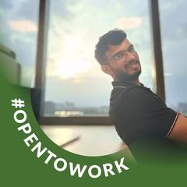

The Team
Yuvish Chintaram
Sankalp Saoji
CEO
COO
Education
Education
BSc Industrial Engineering
MS in Data Science
BSc Electrical Engineering
MS in Entrepreneurship
Experience
Experience
Data Scientist in Textile - 2 Yrs
L'Oreal Brandstorm Top 10 US Finalist 2023
Data Scientist in Retail - 2 Yrs
L'Oreal Brandstorm Top 10 US Finalist 2023
Skills
Skills
Software Development
Machine Learning
Website Development
Product Development
Natural Language Processing
App Development
DRAPER DATA SCIENCE BUSINESS PLAN COMPETITION
DRAPER DATA SCIENCE BUSINESS PLAN COMPETITION

Slide 6


Slide 7
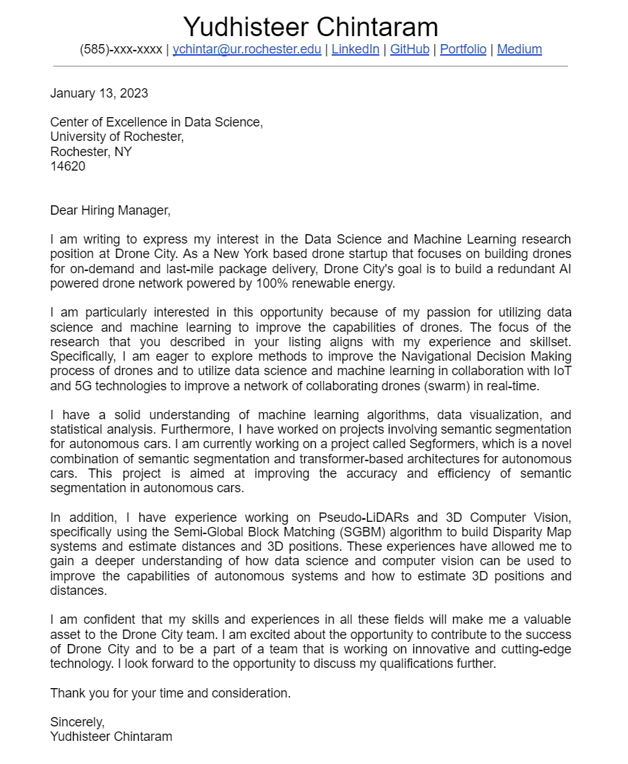
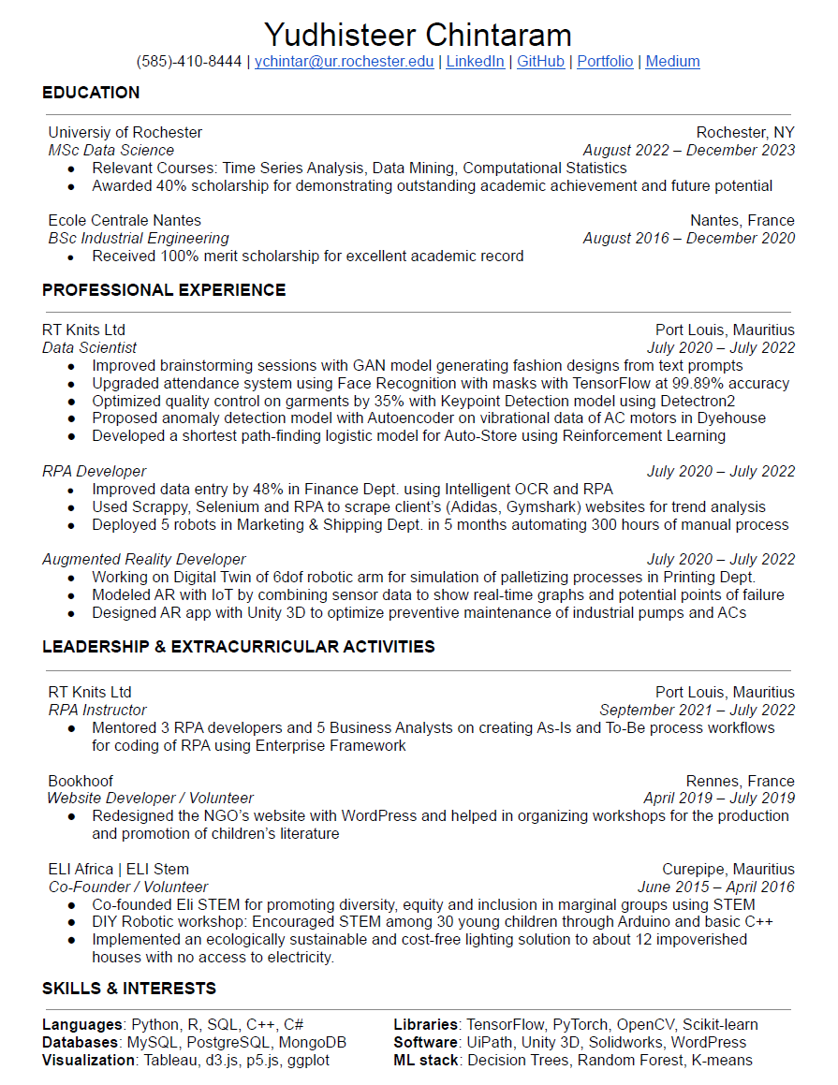
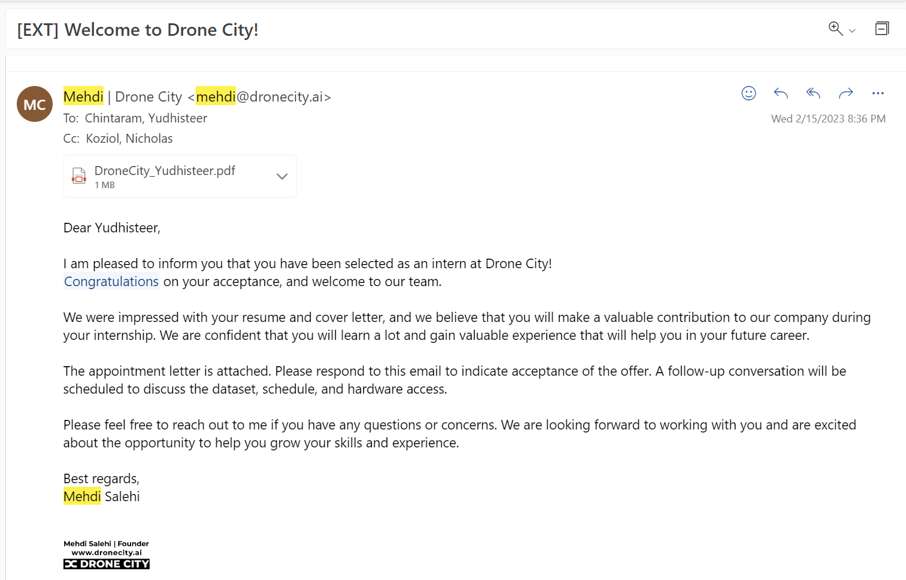
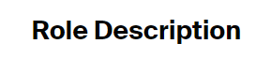
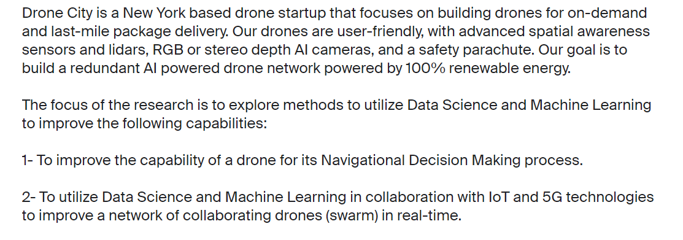
Proof of Concept
DRAPER DATA SCIENCE BUSINESS PLAN COMPETITION
DRAPER DATA SCIENCE BUSINESS PLAN COMPETITION

